Slide 1

Toolkit Doc11 Head Pan Skins
April 30, 2010

Slide 2
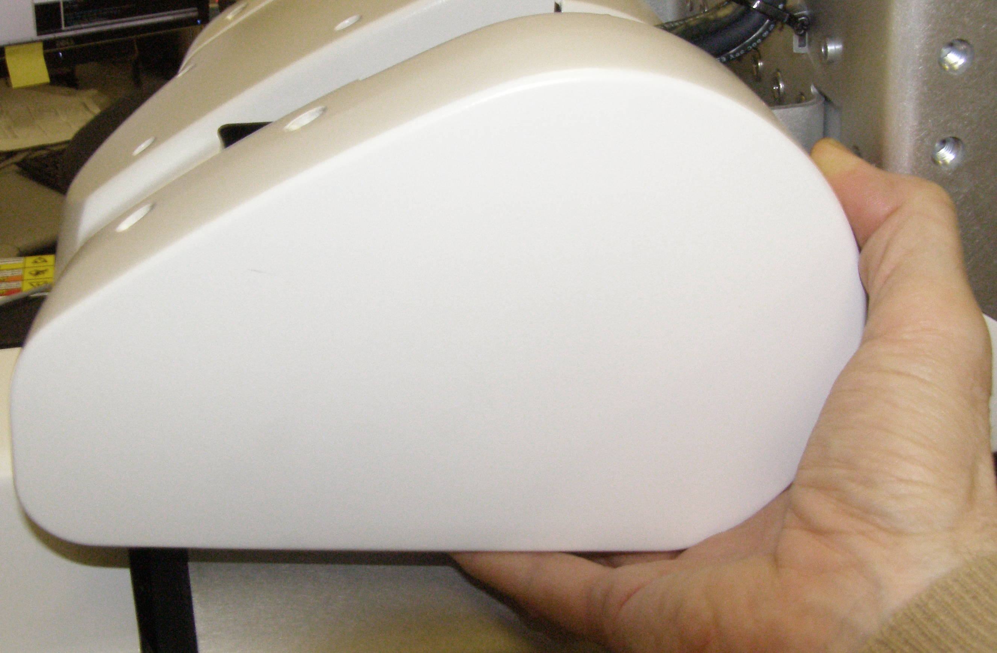
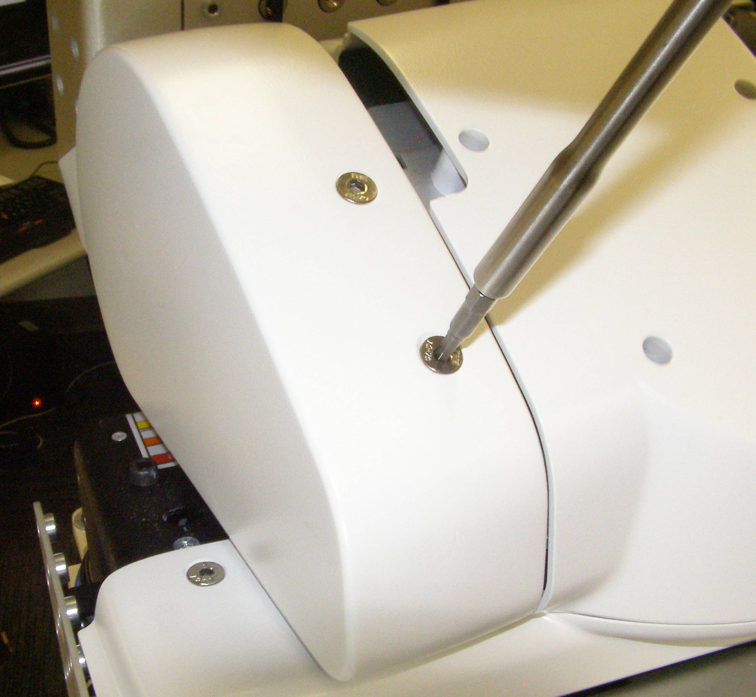
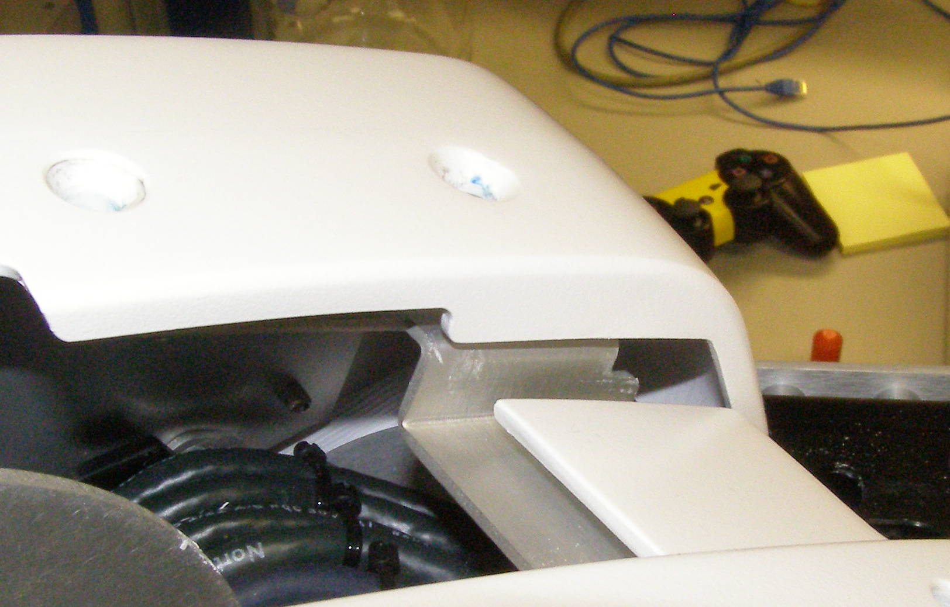
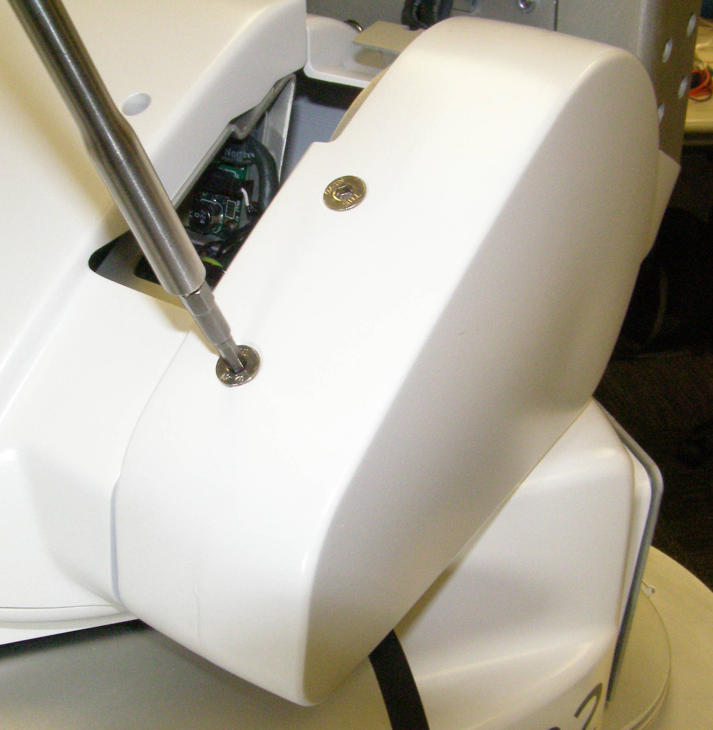
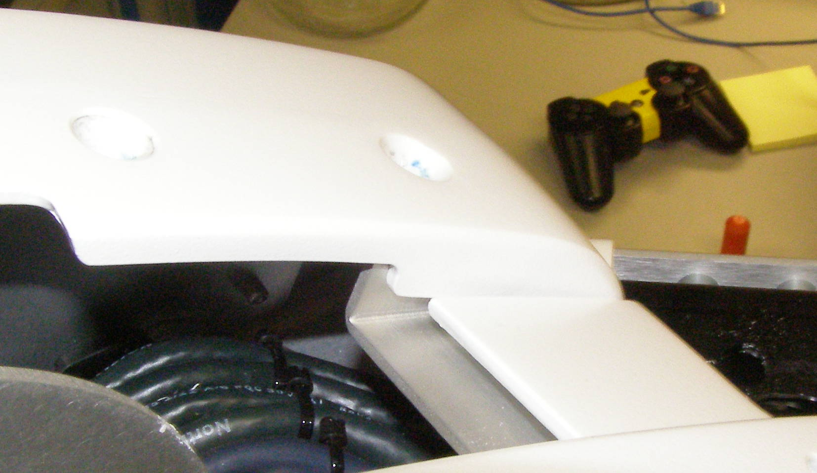
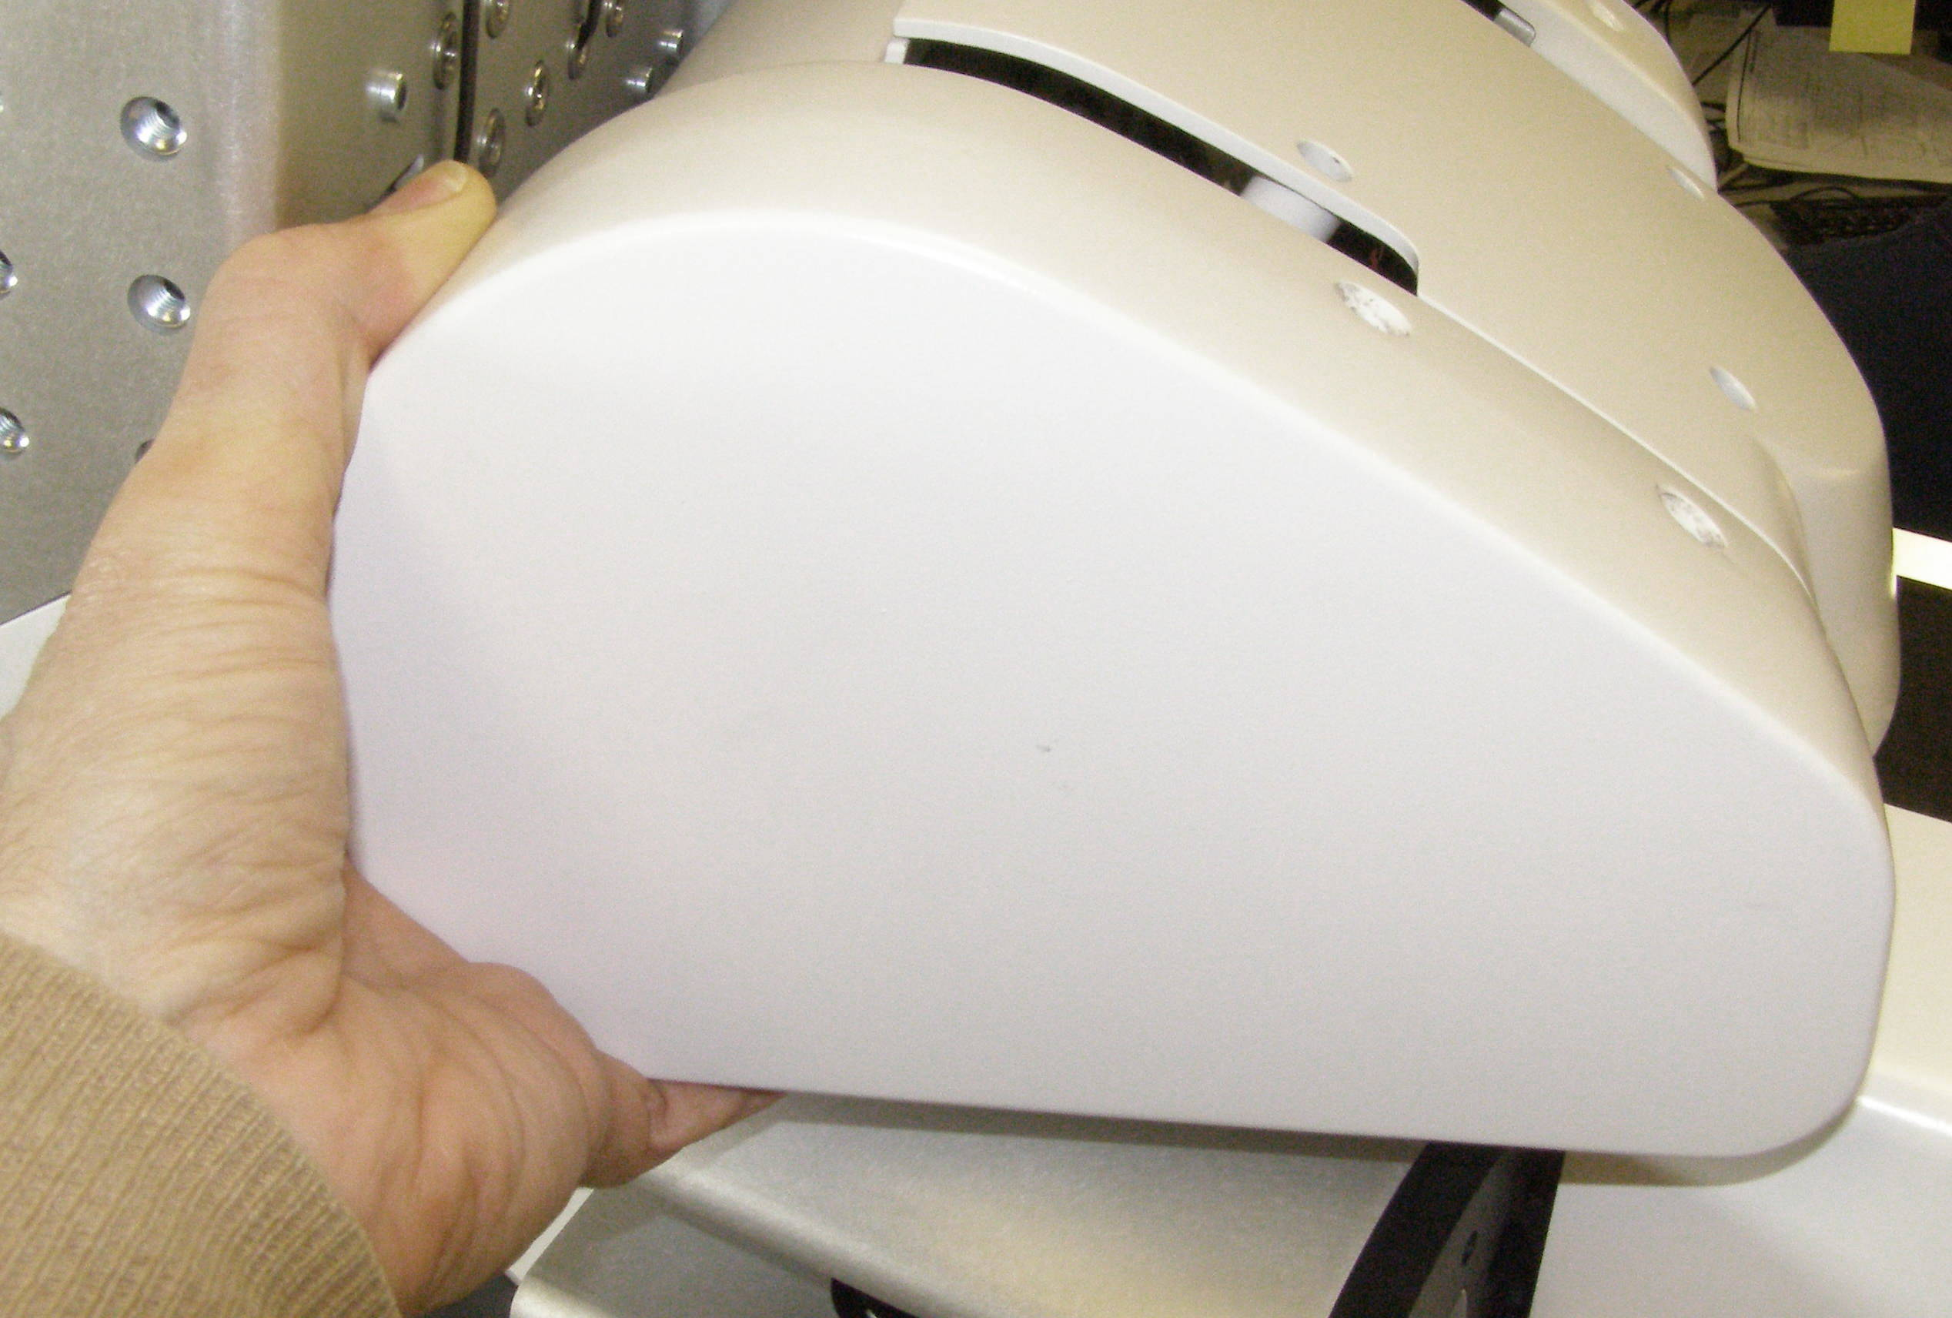
Head Pan Tilt Right + Left R/R
Head Pan-tilt Right – 3181 or
Head Pan-tilt Left – 3183, Removal
  Tilt the Head forward.
  Using the 4mm bit with the T-handle driver, remove 2 screws. 3063-14 (Fig 1,2)
  Grab the front lower corner of the cover and pull out gently until the snap releases. (Fig 3,4)
Fig 1
Fig 4
  For the Right side move the cover slightly to the rear and up to clear the Aluminum boss. (Fig 5)
  Then pull the cover out to remove.
Head Pan-tilt Right or Head Pan-tilt Left, Install
  First slip the rear of the cover over the Aluminum boss. (Fig 6)
  Push the center of the cover until the snap engages.
  Using Loctite 248, install the screws and torque to 1.58Nm using the Large torque driver.
Fig 5
Fig 2
Fig 6
Fig 3

Slide 3
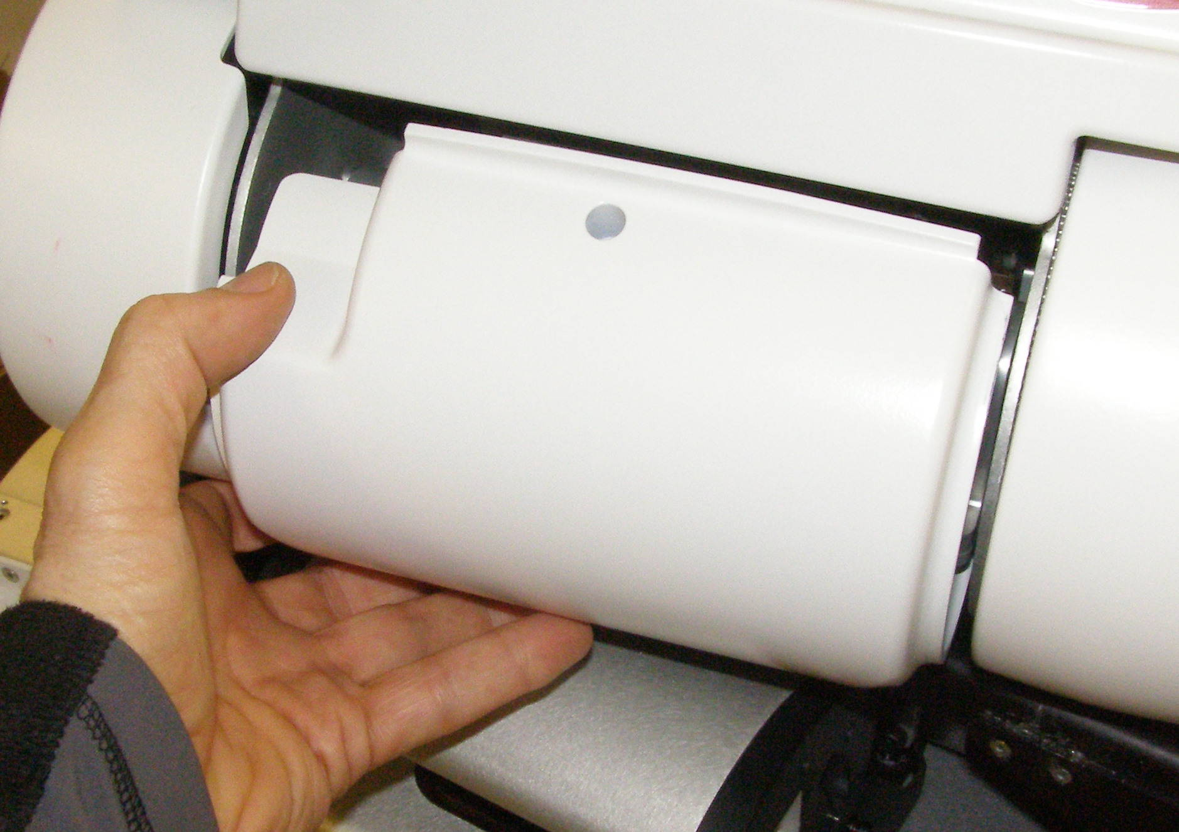
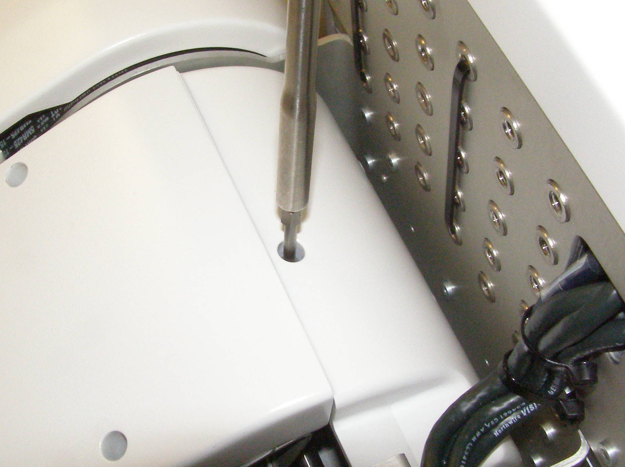
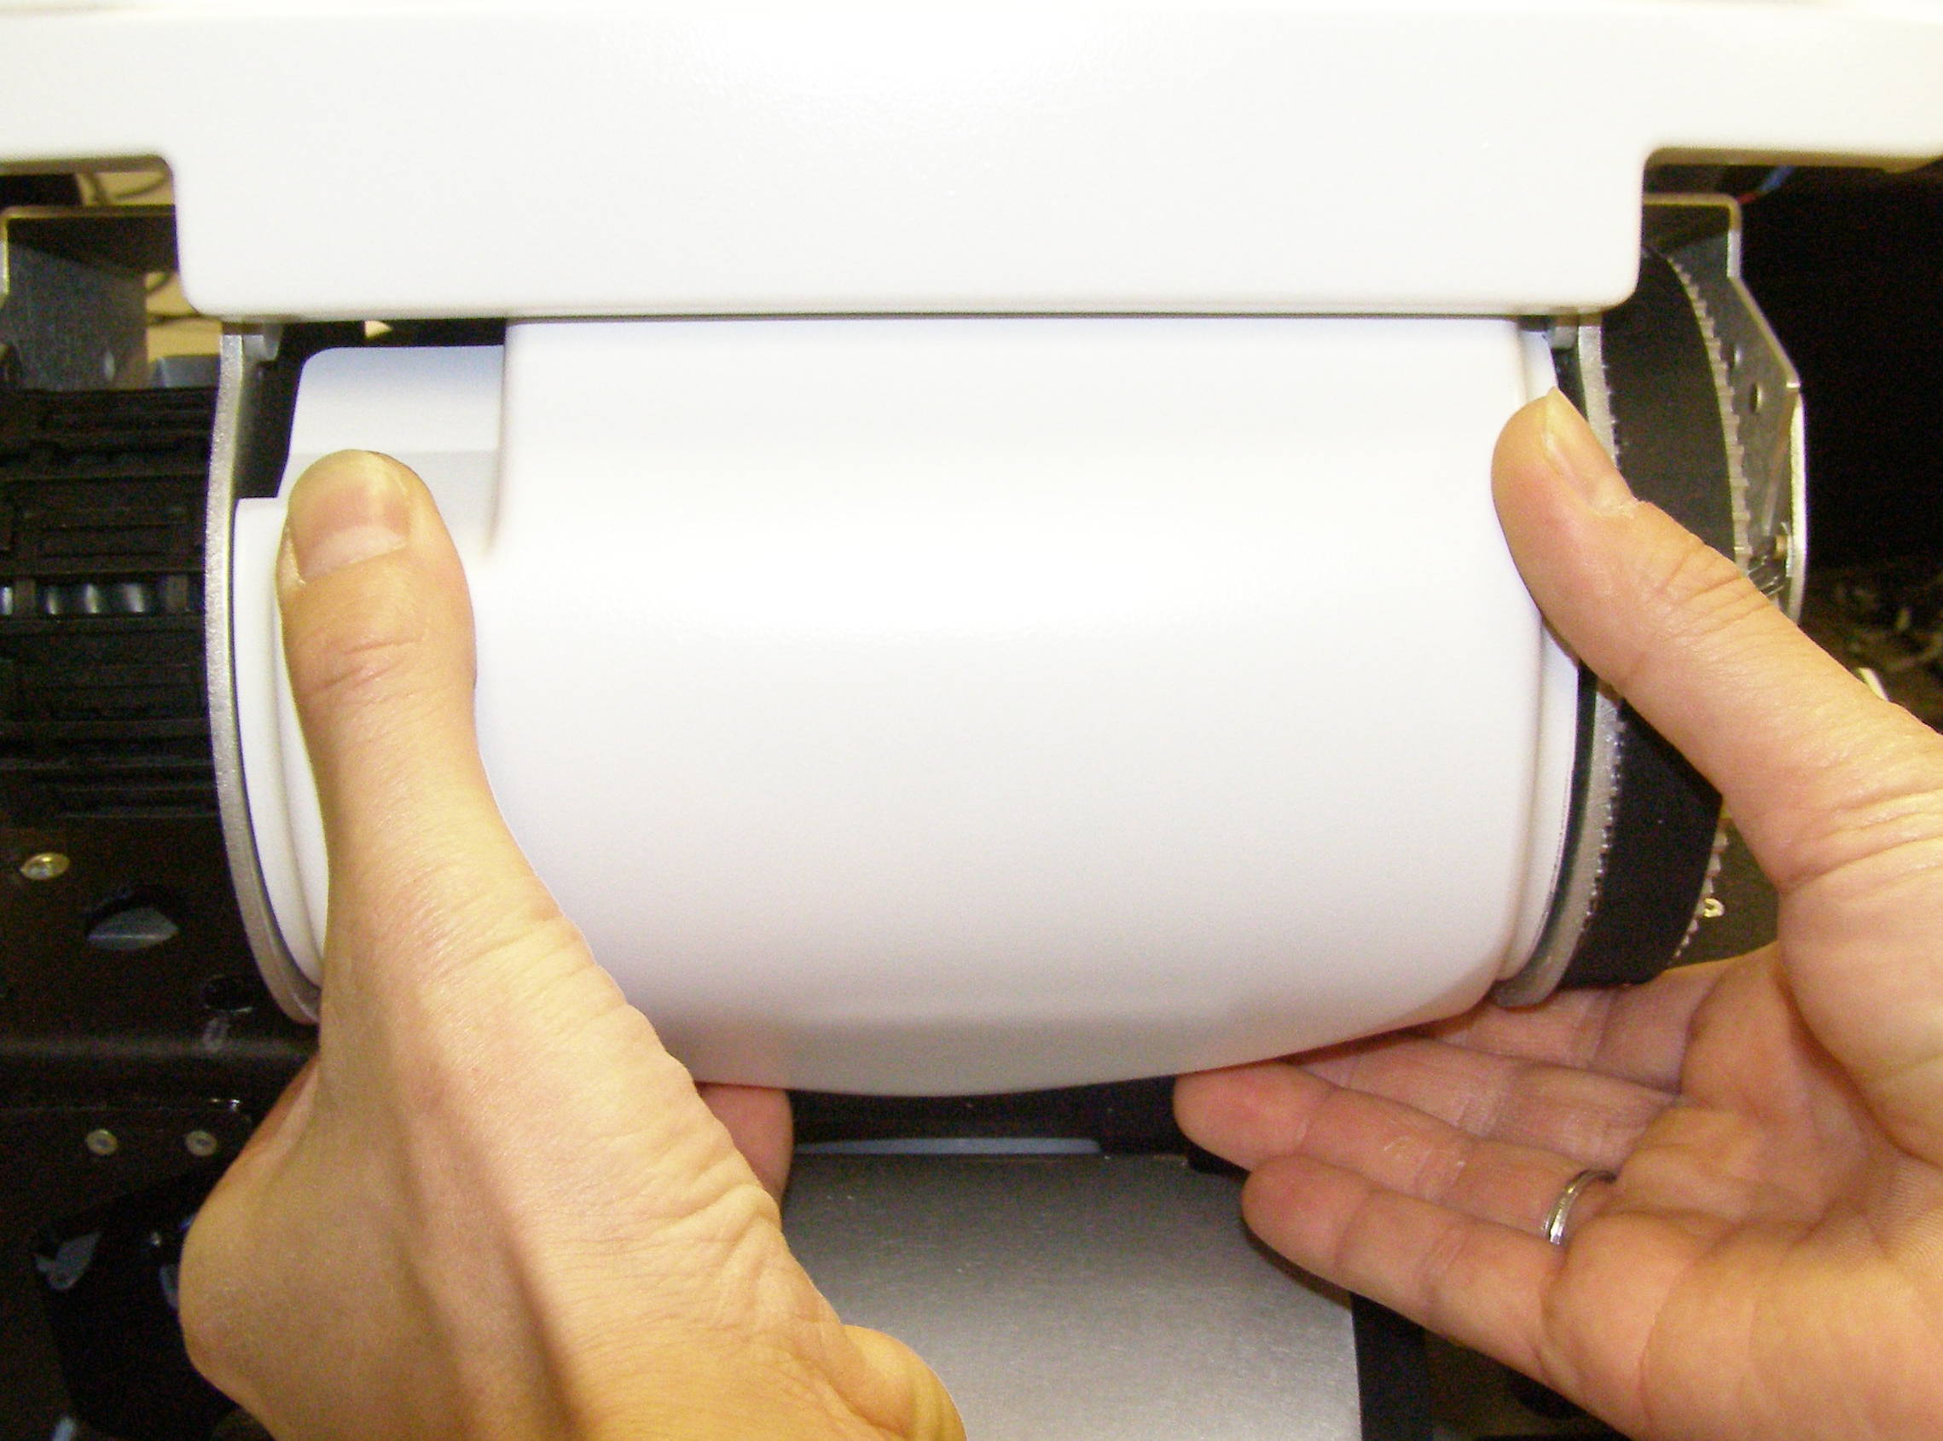
Head Collar R/R
Head Collar, Removal - 3183
  Remove the Top Front Panel.
  Tilt the Head completely forward, and using the 3mm bit with the T-handle driver, remove the screw. (Fig 1)
  Tilt the Head completely backwards. Pulling firmly on the bottom of the Panel, releasing the 2 snaps. (Fig 2)
  With the Panel bottom pulled out about 3cm, rotate the Panel downward to clear the bottom of the Faceplate, then pull out. (Fig 3)
Fig 3
Faceplate
Fig 1
Head Collar, Install
  Reverse the removal procedures.
  Push the center of the cover until the snaps engage.
  Using Loctite 248, install the screw and torque to 1.36Nm using the Large torque driver.
Fig 2

Slide 4
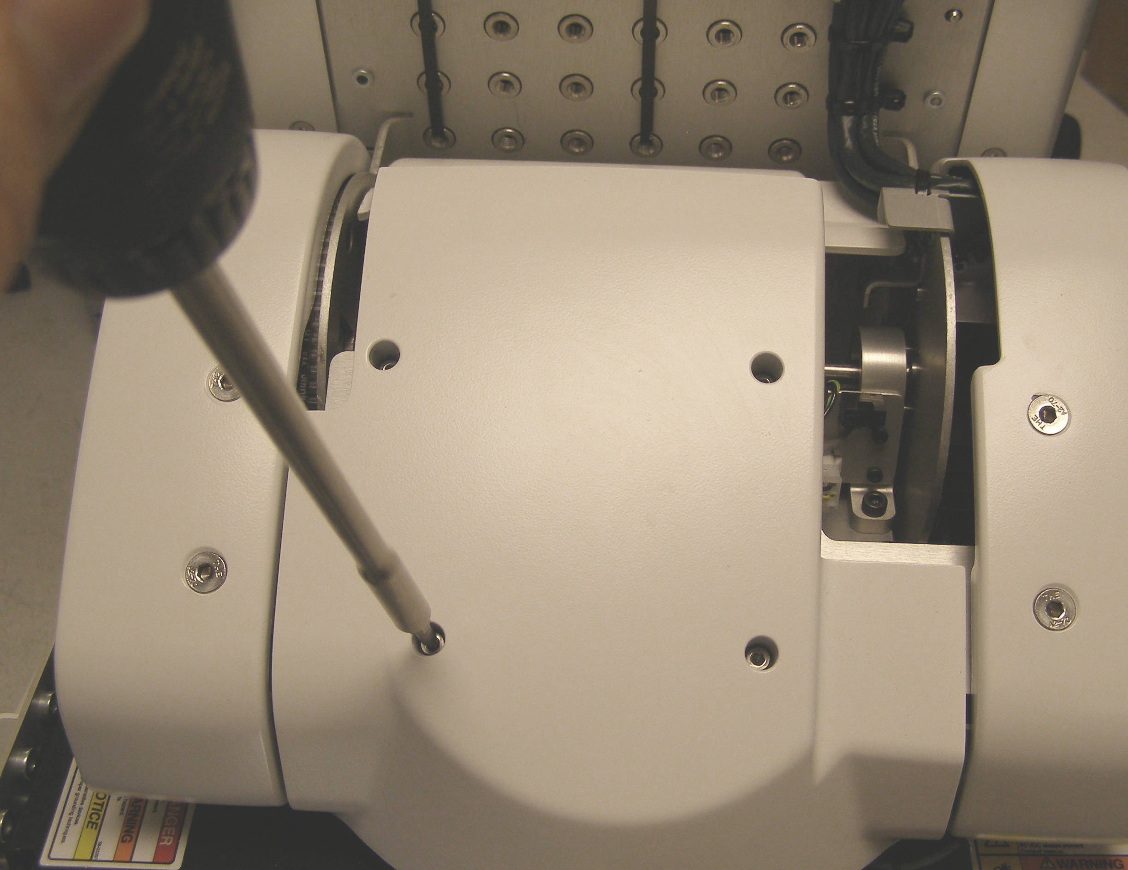
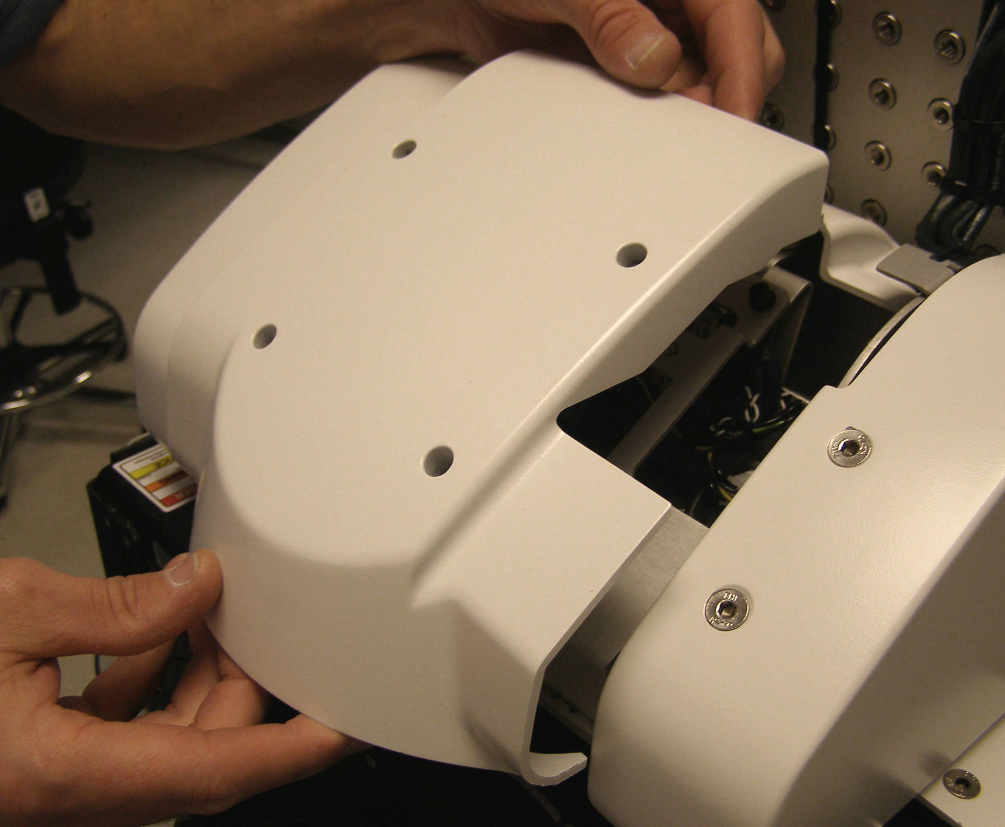
Head Pan Rear R/R
Head Pan Rear, Removal - 2451
  Tilt the Head forward.
  Using the 3mm bit with the T-handle driver, remove the 4 screws. (Fig 1)
  Lift the Panel straight up and off. (Fig 2)
Head Pan Rear, Install
  Reverse the removal procedure.
  Using Loctite 248, install the 4 screws and torque to 1.36Nm using the Large torque driver.
Fig 1
Fig 2

